Slide 1
Nile’s Customer Service Analysis
MUKTI BHUYAN
BATCH 11
HEROVIRED ABADS

Slide 2


About Company & Vision Of Analysis
Nile , an E-commerce company , giving a platform to its clients for shopping of various products under one roof .
Business is spread over 461 cities of 50 states.
Customer Service analysis is done to improve and provide better service from Nile’s to its clients.

Slide 3
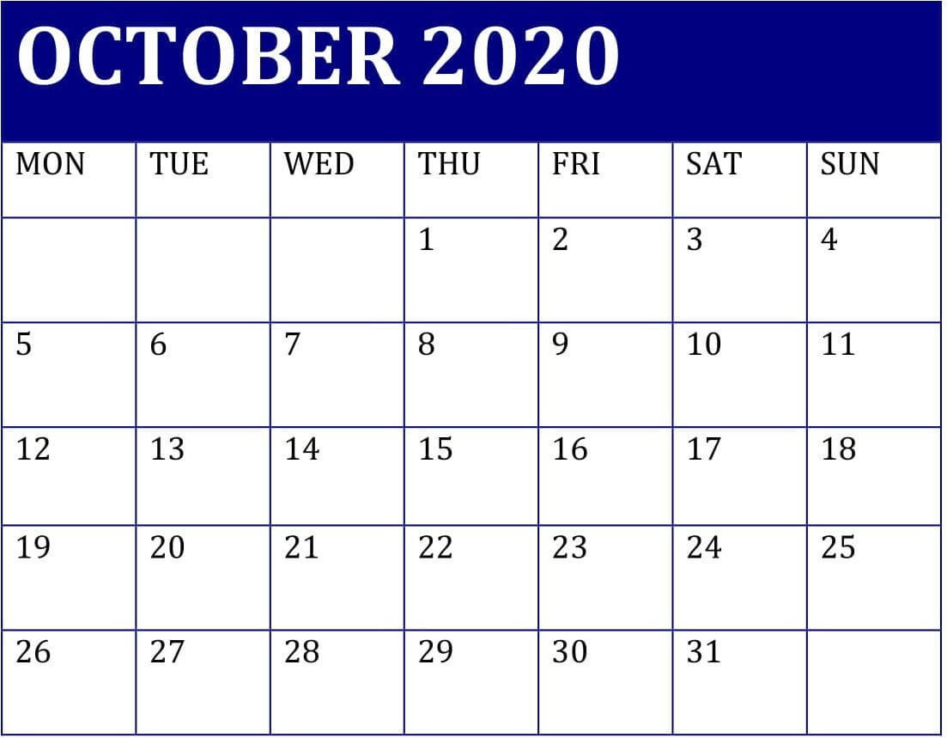

Base Details & Challenges
Base Details:
Total 32941 Customers contacted customer care in the month of October,2020 through call centers, web, Email and chatboat.
Approximately 1100 -1200 calls were handled in October month except 31st oct,2020.
Customer request received from 461 cities of 50 states.
No repetition of customer were seen .
Customer request’s were received across 4 Service centers i.e. Baltimore/MD , Chicago/IL, Denver/CO and Los Angeles/CA.
Date Cleaning:
Headers are corrected to Proper case.
Date format is corrected to uniform format.
States like Delaware , North California,Maine are correctly mapped to respective cities based on percentage of data already available in excel.
Blank CSAT score are filled with average of each category like Positive , Negative and Neutral reactions received from customer.
Challenges In Data:
Basic details like Product category, Gender, payment mode, phone
number etc. are not available to check the pattern of queries received under
what product, repeating customer (if any), gender based shopping etc.
CSAT Score available by only 30%.
No name/ employee code of customer care agent available to check the
efficiency of request serviced and strength of team.

Slide 4
Root Cause Analysis
Request received mainly in 3 categories like Billing Questions ,Payments and Service Outage
Billing Question comprises to approximately 72% of total request , Payments by 14% and Service outage 14%.
All payments related request were received at Call Centers only.
Billing Question contributes to 72% on total request received and out of that Below SLA & Within SLA together (%) comes to approx. 62% of response time and further approx. 37 %for negative reactions received from Billing Questions only.
Note: Sentiments like Positive & Very Positive are segregated as Positive. Same way Negative & very negative
are counted as Negative.

Slide 5
Service Centre efficiency & Response time -1
Total 4 service centers handled 32941 customer request in the month of October,2020.
Request are received from 461 Cities of 50 states.
Los Angeles (13734) and Baltimore (11012) jointly handled 75% of total request across 4 Service centers.
Denver being at lowest productivity center, serviced only approx. 9% of total request and
also 50% of reactions received are negative.
Chicago Centre at second lowest productivity ,contributed to 16% of total request serviced.
Approximately 31% of total request are jointly received from California (3631(11.02%)),
Texas (3572(10.84%)) & Florida(2834(8.60%)) out of 50 states. And again 75% of
these request were serviced by Los Angeles & Baltimore centers.
California and Texas received 5.72% each as highest Negative Sentiment. As the volume
is more from these states so is the sentiment.
Note: Sentiments like Positive & Very Positive are segregated as Positive. Same way Negative & very negative
are counted as Negative.

Slide 6
Service Centre efficiency & Response time-2
All Payments related queries were resolved through call center only.
Service outage request were resolved only through EMAIL,CHATBOAT & WEB.
Request Serviced through Call center were 32.30%, Chatboat 25.06,Email 22.68% and WEB at 19.96%
87.35% of total queries/request were resolved Below SLA(24.74%) & Within SLA(62.61%).
Within normal time duration i.e. upto 15 minutes 26% of queries were resolved and 37% respectively for Average & High duration calls.
Note: Above referred duration is bifurcated to slab i.e. Normal : 0-15 minutes, Average : 15.01-30 Minutes and High > 30.01Minutes

Slide 7
Sentiment analysis
Positive reaction from customer is 21% ,followed by Neutral reaction at 27%.
Negative reactions received in Oct,20. contributes to 52% of total request serviced.
Billing questions invited more of negative reactions. Refer :Root Cause Analysis.
87.35% of total request were resolved Below SLA(24.74%) & Within SLA(62.61%),
however even after getting higher % of resolution with in above mentioned time frame
These request received reactions as Positive 18.75%, Negative 45.28 % and
Neutral 23.31% .
Baltimore & LA Service Centre together got positive response of 16.28% and Negative
reactions by 39%.

Slide 8
Recommendations based on observations
More historical data (3 – 6 months) with some more details like Product purchased , Gender ,Income , Age , Phone number, employee code etc. should be provided and further analyzed to reach on a better recommendation.
Billing Question request comprises 75% of total queries, it is advisable that billing task should be outsourced (third party vendor) to some professional company for better services looking at the volume of request received.
Service Outage request are only received through CHAT/EMAIL/WEB, if we encourage customer to place a call ,request can be serviced faster. This part can be minimized.
There is only 01 call received on 31/10/2020, so reason of same should be probed if there were any technical issue or any other reason and rectification steps should be taken to avoid same. It may lead to customer frustration leading to further impact on business. (Root Cause Analysis of only 01 call received on 31/10/2020)
Denver (8%) & Chicago(16%) are two centers with low productivity and centers like LA & Baltimore are over stressed so either queries can be routed to Denver & Chicago OR Their team should be increased by more members to enhance team efficiency . Also if we shut down Denver & Chicago centers , it will reduce expenses of operational cost in company’s books.
Negative reaction are 52% of total request received. So, quality check for customer care agent call efficiency(like how was their tone , how efficiently they handled client issue, their call duration) should be done and their issue handling skills need to be evaluated. Training should be conducted in regular interval for agent lacking skills .

Slide 9
Thank you
Notes:
In Slide Show mode, click the arrow to enter the PowerPoint Getting Started Center.

